Slide 1
ISF - Project Board Update
January 2014
ERS draft input for discussion

Slide 2
1

Slide 4
Current Status
Q4 2013 saw the undertaking and completion of the feedback sessions and practical demonstrations around the proof of concept.
The SNOMED terminology bindings have just been completed and have been sent (January 2014) to the NHS Terminology Centre for Quality Assurance.
A demonstration of the model and standarised data architecture was provided in feedback sessions provided during December. This was based on a platforms currently deployed in a similar European settings.
ERS have commenced the write up of the report, which is running to schedule with a completion date of the 31st March 2014.

Slide 5
Deliverables
The main deliverable from this piece of work will be the (high level) Data Model. The main purpose of the Data Model is to support the alignment and standardisation of our ICT systems by providing the definition, structure and format of the data.
Other related deliverables within the model include the standards based specification for key components and support processes. Also, a proof-of-concept based on the epSOS Patient Summary Data Set.
When deployed the Data Model will bring consistency, flexibility and a more stable data sharing and software applications environment. It will also help with the procurement process.

Slide 6
Application
What is ‘its’?
IA-RN, SAM’s, Data Dictionary, tooling and supporting documentation
The project scope does not include deployment of the model, merely its standards based definition and validation at a semantic level through the (epSOS based) Patient Summary Dataset within it and the SNOMED CT bindings to the data elements.
The Project Board or Project Sponsor may wish to consider early adoption of ISF project outcomes (IA-RM, SAM’s, Data Dictionary, Tooling and supporting documentation) in a number of ways including:
Release of a Standards Reference List and appropriate SAM’s for early application in the Procurement Cycle
Integration with one or more large systems eg. iPIMS, NIMIS, MedLIS, NCIS for the purposes of Dataset Alignment, Terminology Alignment and quality assurance
Adoption for the purposes of helping Clinical Programmes define and input their Datasets
Use as conformance testing facility for HSE and IT-providers
Use as a system-to-system messaging platform based on EN 13606 to complement Healthlink
Use for the purposes of developing and testing Electronic Health Records (EHRs) based on ISO/ EN 13606

Slide 7
Application Options
ERS makes use in its software solutions of some open source components, but the ERS software is NOT free and NOT open source.
Procurement of HSE Tooling Environment (Data Utility Platform) for:
  Editor: to model, produce Archetypes and Subject Area Models (SAM’s)
  Data Dictionary: Library of SAM’s, as Data Dictionary
  Initial proposed SAM’s:
    epSOS Patient Summary data set (harmonised with EN13606, SIAMM and ContSys), mapped to HIQA Discharge Summary
    T.B.D.: Demographics (ISO 22220 Subject of Care Identification), mapped to HIQA Demographics
  Artefact Knowledge Manager: tooling to handle user groups and the Documents for Reviewing and Consensus based Quality Assuring of HSE Archetypes and SAM’s Securing Uniqueness and Complementary of each single Archetype and SAM’s. A HSE Library of Artefacts (ISO13606, HL7v2.4 etc.) including various exports of 13606/SAM’s into Human readable Mind Maps and Excel and Computer processable HTML, ADL, XML and Schematron
  as a baseline and dedication of three fulltime staff
Procurement of ’Commercial’ Software Tooling (€300 K initial license plus maintenance (60K per year) and dedication of three fulltime staff. Installation (10K). Third Party Software cost are ‘nihil’ because of the use of open source solutions. Need for SLA to be assessed, because depending of roles allocated with ERS by HSE.
Procurement of the ‘Commercial’ solution from ERS under a SaaS arrangement Tooling (€12K/month; minimum duration of 1 year)
Procurement of the Content (SAM) development by ERS, exclusive Terminology bindings, under a Content / SAM’s (CaaS) arrangement (€25K/month for min. 1 year for the production of 3600 – 4000 archetypes)
Adoption of an alternative approach such as available from 3M, IBM etc. (€??? K)
Contradiction
As far as we know 3M and other commercial products can not be compared with the ERS solution.
3M is an active data dictionary focussing on lists of words and mapping of those words to coding systems.
3M does not fully deal with data structures that can support the SAM’s and IA-RM.

Slide 8
Terminology Service
Terminology Adoption based upon outsourced arrangement with the NHS
Terminology Adoption based upon a hosted 3rd party arrangement eg ERS, Academic COE or Equivalent
(It is assumed In house resourcing is not an option)

Slide 9
ERS Solution Proposals
ERS Proposal-1 for Next Stage
(Solution based around MedLIS/ LIMS
Subject of Care Identification)
Using Demographics SAM as developed for epSOS Patient Summary
Step 1: Mapping of demographic data LIS’s (6) to SAM in ERS Mapping Tool as foundation
Step 2: Mapping of demographic data MedLis to SAM In ERS Mapping Tool as foundation
Step 3: Validation by trial integration of data from LIMS-systems and MedLis using ERS Testing Infrastructure (Integration Engine, ISO 13606 supportive Persistence and Application/Viewer)
Ballpark costs: 50K euro; duration 2 months
Next Phase: Create SAM for Lab data

Slide 10
ERS Proposal-5 for Next Stage
(Solution based around iSOFT/ PAS
Subject of Care Identification)
Using Demographics SAM as developed for epSOS Patient Summary
Step 1: Mapping of demographic data from iSoft/PAS to Demographics SAM as foundation
Step 2: Validation by trial integration of data from iSoft / PAS to LIMS-systems and MedLis
Ballpark costs: 5K Euro; duration 2 weeks
Next step: Create SAM for Order Communication

Slide 11
ERS Proposal-2 for Next Stage
(Solution based around Ireland South/ North cross-border National Patient Summary Dataset Exchange )
Scoping study required
Implementing epSOS PS
(printed/eMail copy, or Portal) from Local PAS/HIS
Needed: Integration PAS/HIS with ERS CESIL (cross Enterprise Semantic Interoperability Layer)
Ballpark PS costs: 50K Euro per PAS/HIS;
Ballpark Software initial license costs for modules (Integration Engine, Persistence, Basic Application/Viewer) per hospital: 150K Euro
Future All Ireland Children Hosp. / epSOS developments in EU

Slide 12
ERS Proposal-3 for Next Stage
(Solution based around NICIS – National Child Immunisation System)
Scoping study
Integration cost based on scoping
(±20-50k per site/system)
Define SAM for NCIS treatment as part of ongoing SAM development
Building a cross enterprise central NCIS System : ±1 million Euro

Slide 13
ERS Proposal-4 for Next Stage
(Solution based around National Diabetes System)
Integration cost based on scoping
(±20-50k per site/system)
Define SAM for Diabetes treatment as part of ongoing SAM development
Building a cross enterprise central Diabetes System : ±1 million Euro

Slide 14
Academic / EU Collaboration
H2020-PHC-2014-single-stageSub call of: H2020-PHC-2014-2015
Irish Medicines Board
Academia
IPU
INMWO
NHS
HSE
Cross Border Treatment
SNOMED CT
Connecting Europe Facility
Standards Alignment

Slide 15
2014 Tenders
Technical Work Stream:
ERS assumes for example an IHE Infrastructure to find, send, receive and authorise

Slide 16
Access & Governanace Workstream
  Governance is technical and health specific
  Technical governance is via the parsers available in the ERS tooling
  Health specific governance needs to be done via a viewer/inspector
  Sites push a ‘message’ to the Validation Server and presents the results for inspection

Slide 17
How to deal with HealthLInk
  HealthLink is using HL7v2 messages
  ERS proposes to create a transformation from and to HL7v2 artefacts
  and connect HealthLink and its custoners to the HSE ‘Virtual Data Bus’
15

Slide 18
Project Board Decisions Needed on

Slide 19
END

Slide 20
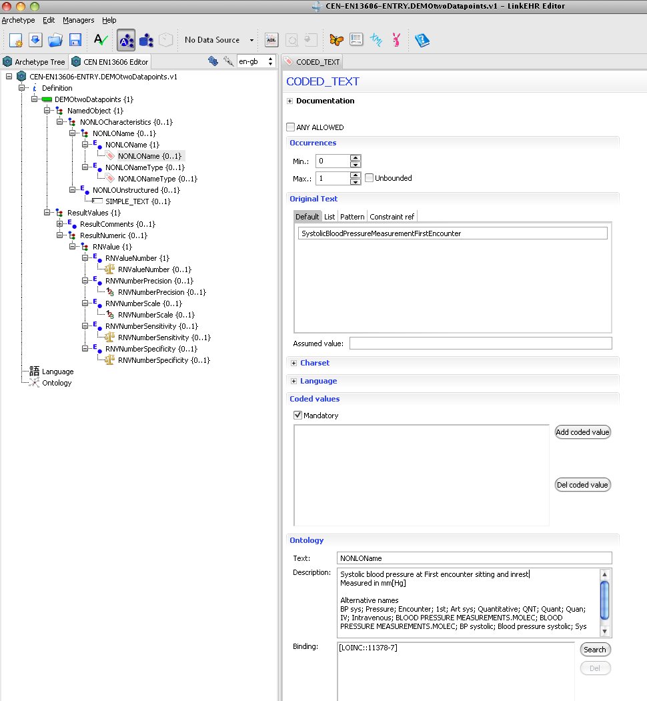
Demo Data Point in Archetype
Definition of Concept
Allows to define how many times the measurement is allowed to occur
Description of Concept
Codes attached to the concept

Slide 21
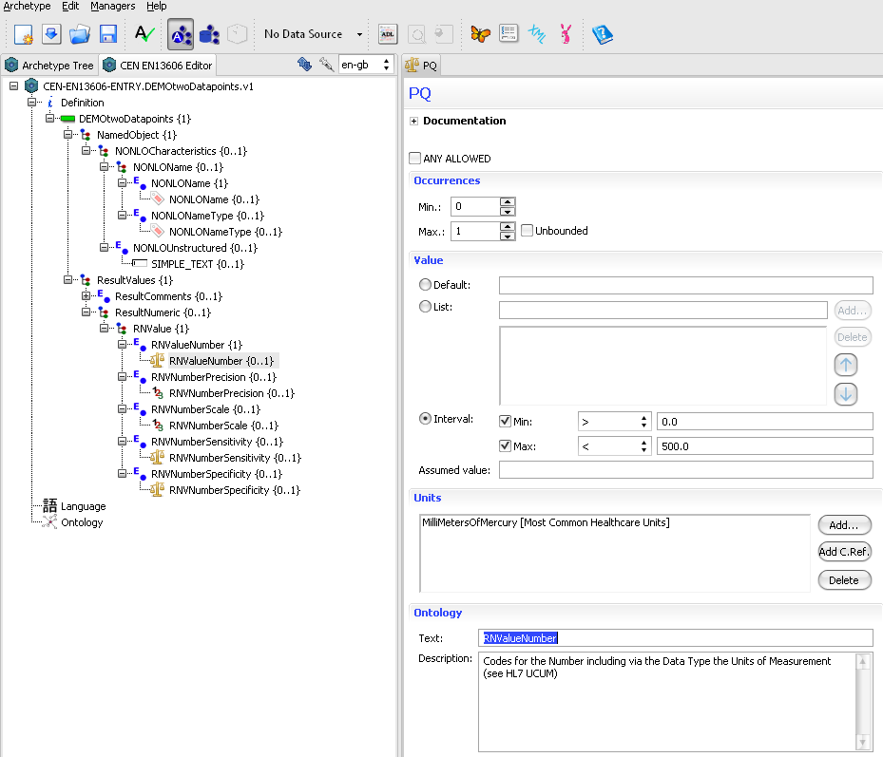
Demo Archetype
Associated Value
Allow precise spec of expected result
Allows precise spec of expected result

Slide 22
